Slide 1
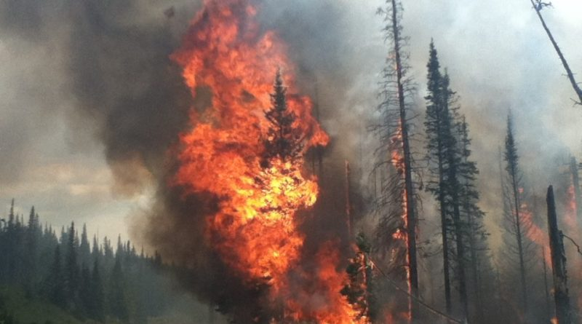

Scorched!
An analysis of
U.S. Wildfires
from 1992-2015
By
k.E.G.d
Katlin, Enzo,
Graham, and Danieli

Slide 2
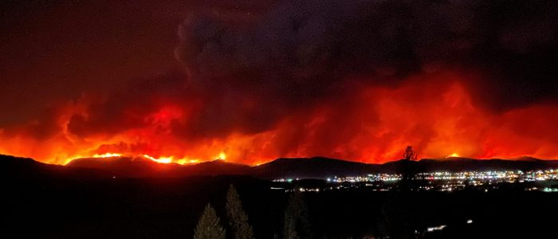
Why Study Wildfires?
Per the Environmental Protection Agency,
Wildfires have the potential to harm property, livelihoods, and human health.
1980-2020: 18 wildfire events that caused more than $1 billion in damage; 15 of those have occurred since 2000.
Over the past few decades, the United States has routinely spent more than $1 billion per year to fight wildfires, including $1.6 billion in 2019.
These efforts have resulted in the deaths of more than 1,000 firefighters since 1910.
Wildfire smoke has been directly linked to poor air quality that can lead to significant health effects and costs to society.
Multiple studies have found that climate change has already led to an increase in wildfire season length, wildfire frequency, and burned area.

Slide 3
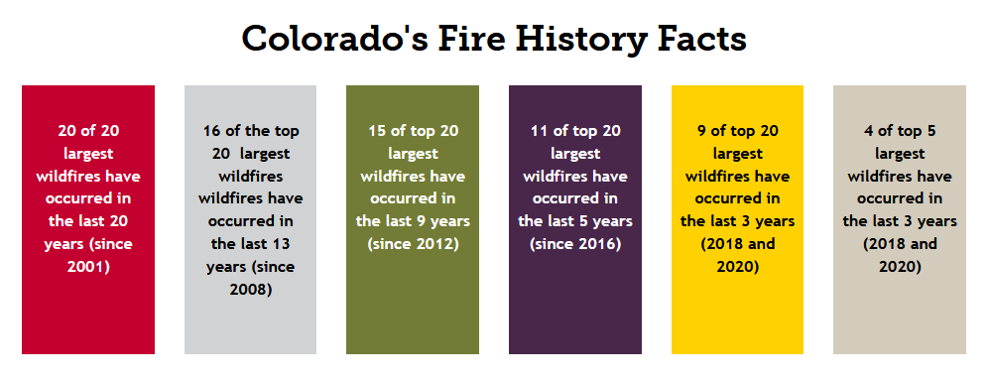
Why Study Wildfires?
Wildfires affect us all!
Per the Colorado Division of Fire Prevention and Control

Slide 4
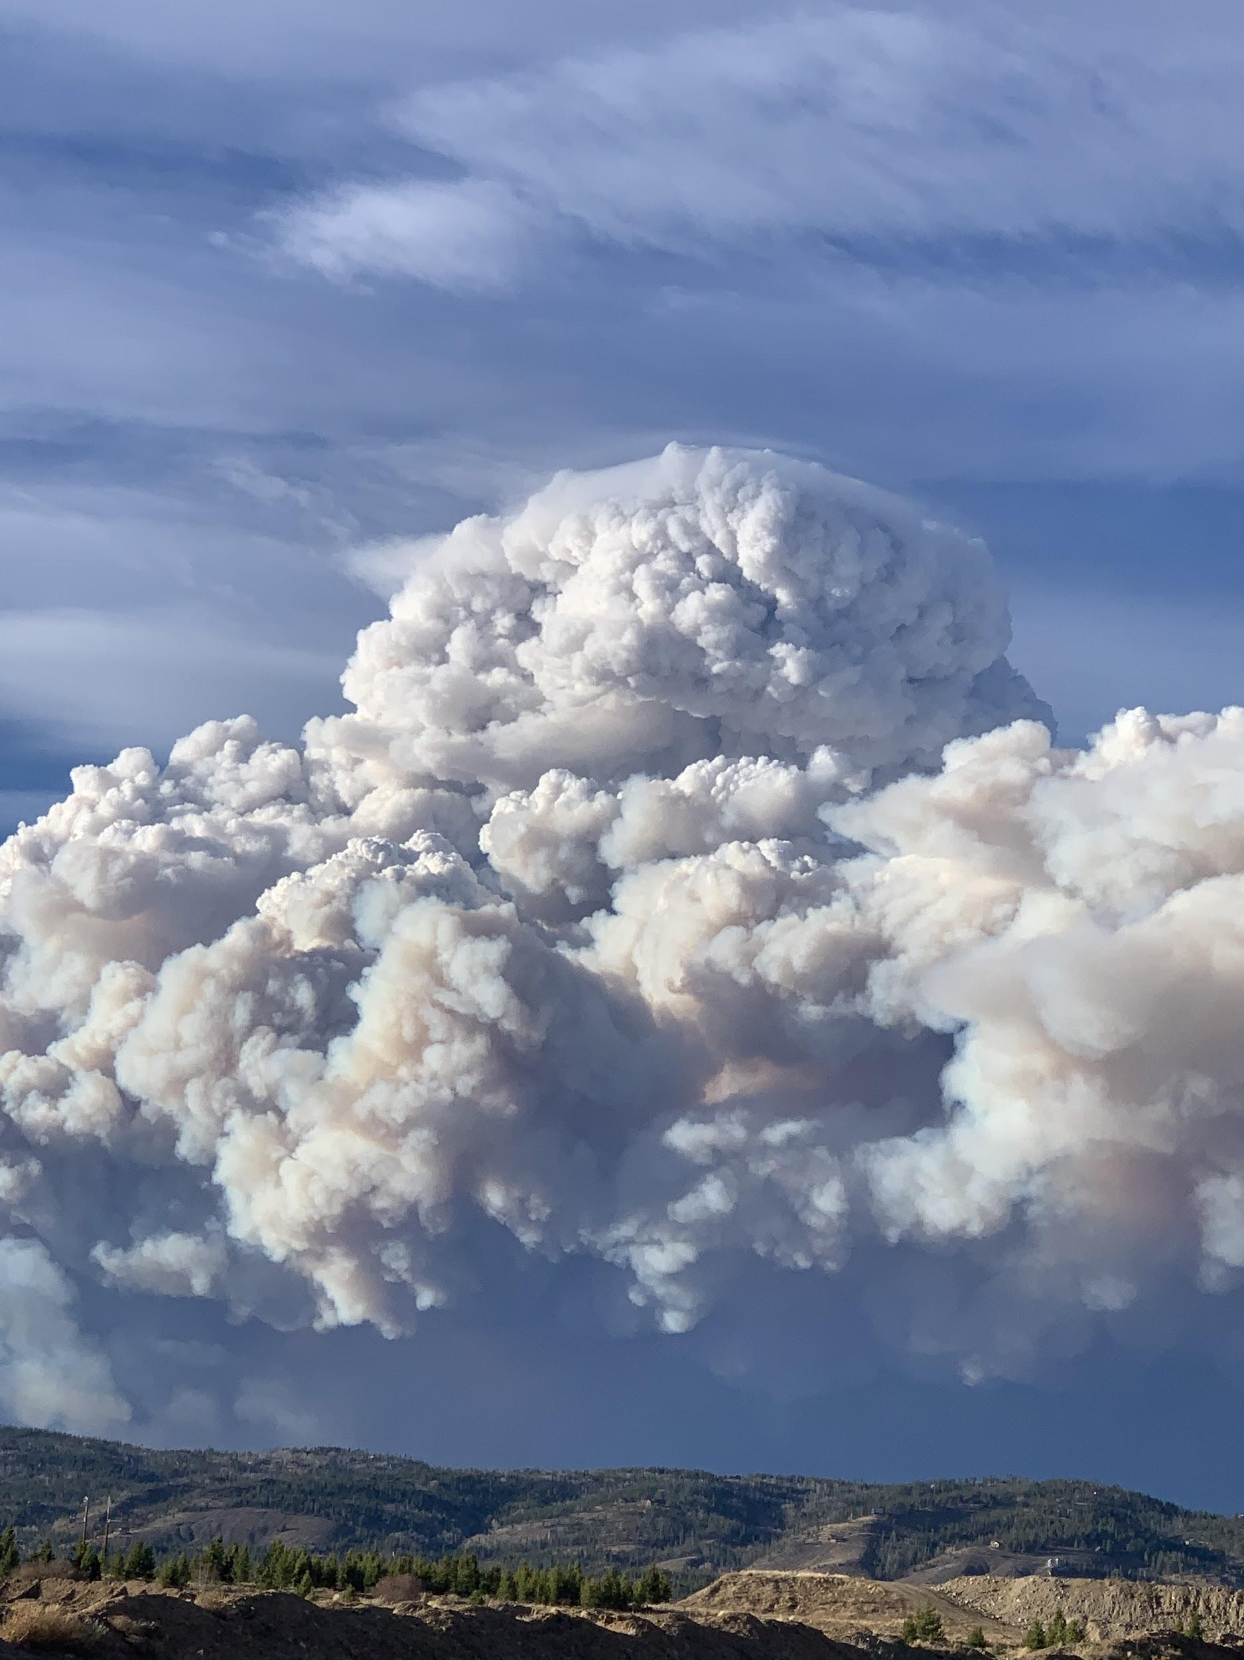
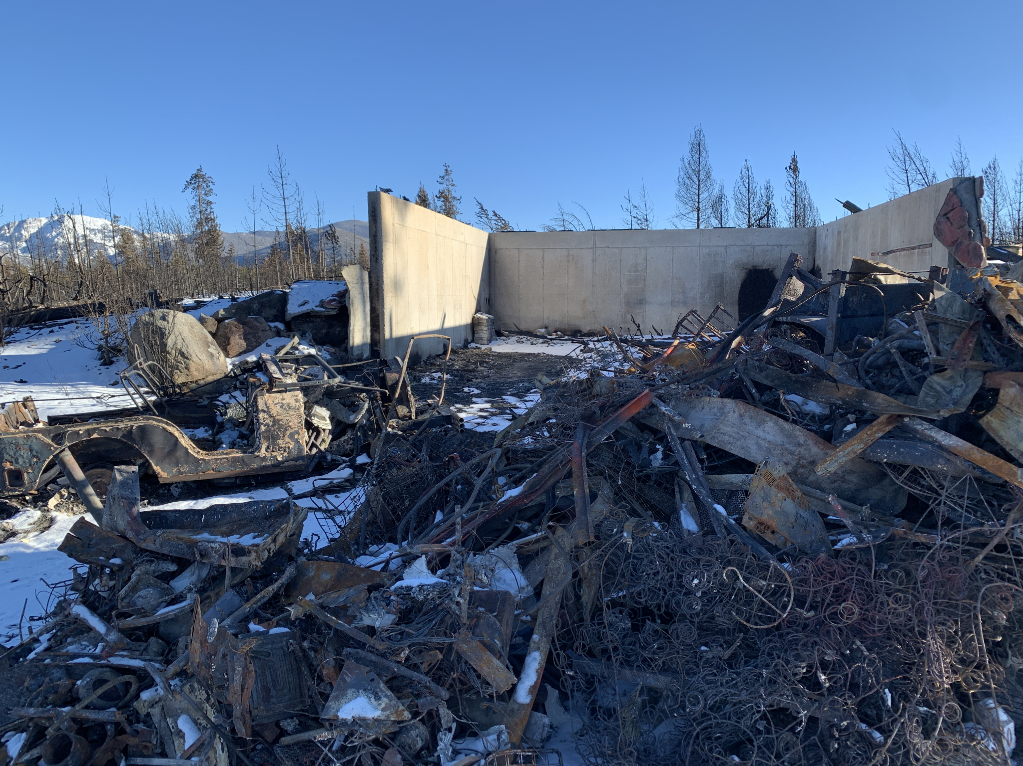
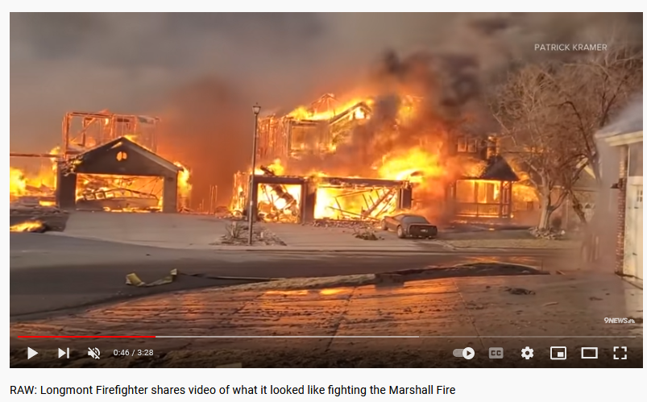
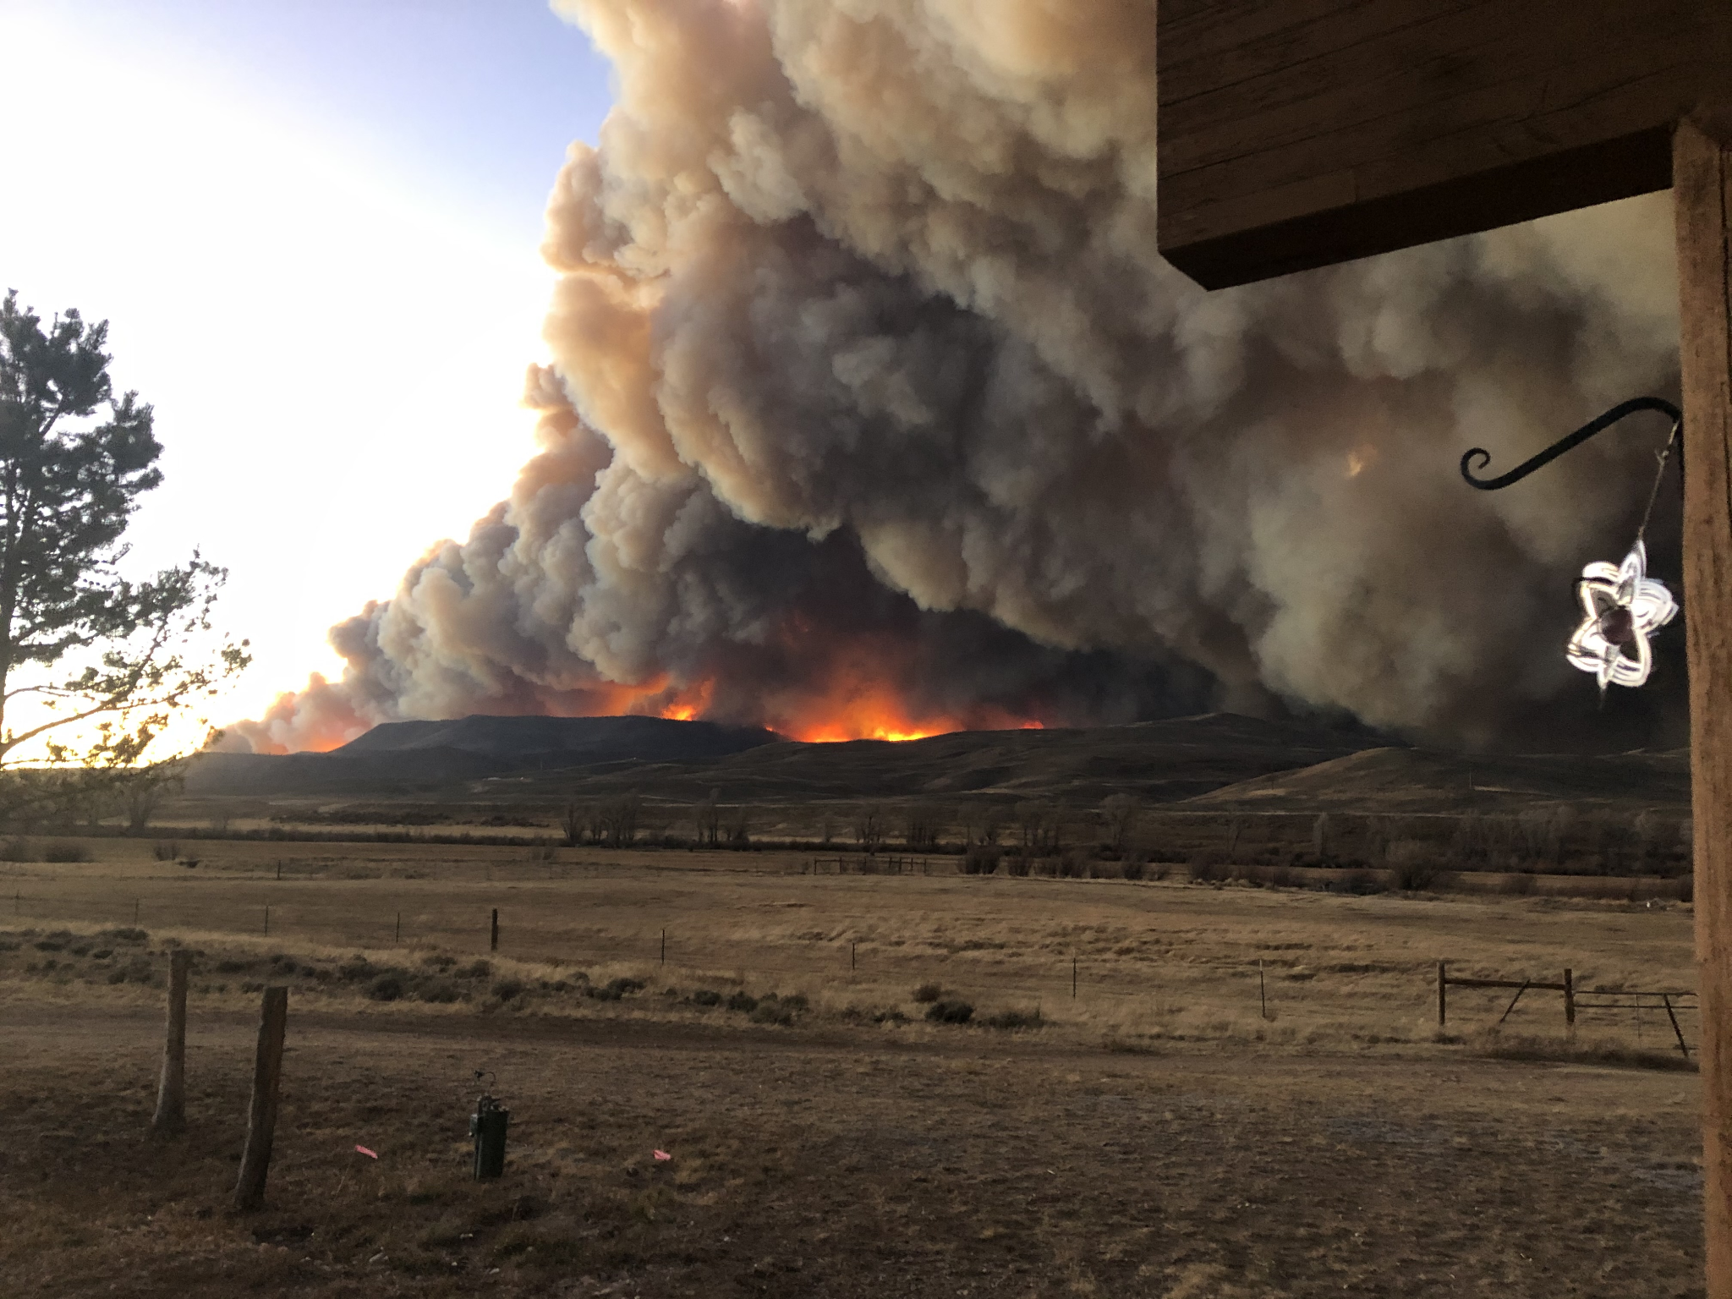
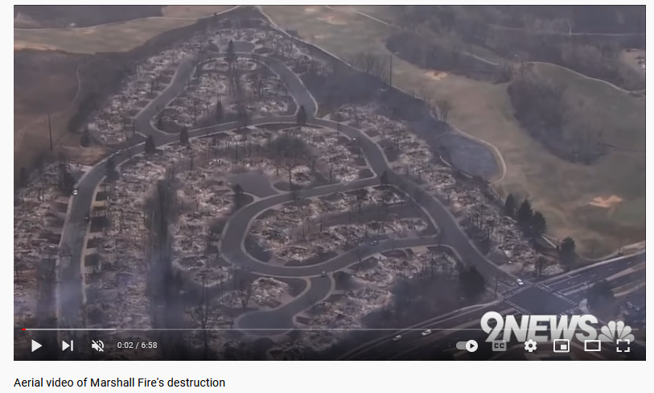
Why Study Wildfires?
East Troublesome Fire, Oct 2020
Marshall Fire, Dec 2021

Slide 5
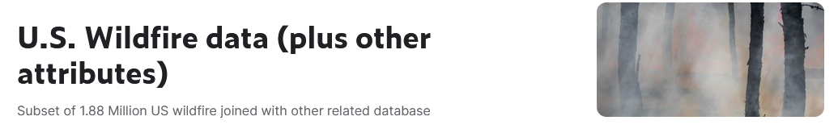

Data Source
U.S. Wildfire data (plus other attributes)
https://www.kaggle.com/datasets/capcloudcoder/us-wildfire-data-plus-other-attributes
Entire dataset includes 43 columns and 55,368 rows
Most relevant columns:
Year
Fire Size
Fire Cause
State
Month
Vegetation
Temperature (multiple columns)
Wind (multiple columns)
Humidity (multiple columns)
Precipitation (multiple columns)
Remoteness

Slide 6
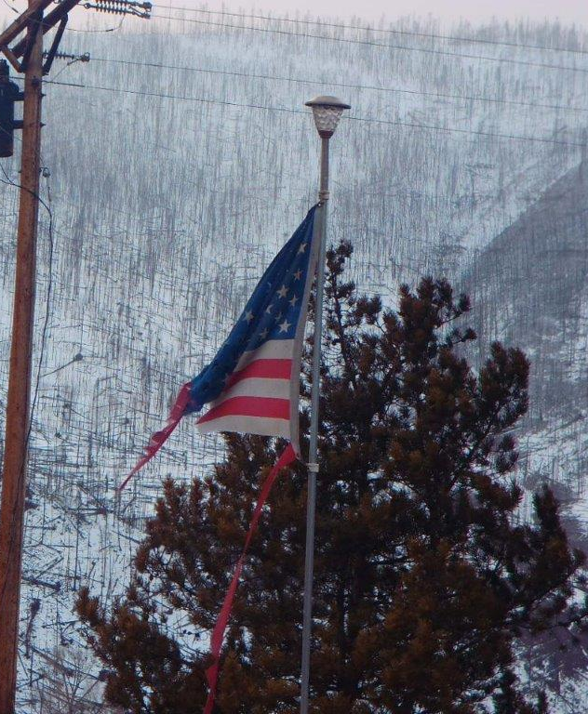
Questions to Investigate
Has the number, size, and cause of wildfires changed over time?
Has the timing and distribution of wildfires changed over time?
What temperature, wind, and humidity conditions are most likely to result in large wildfires?

Slide 7



What to do about Wildfire
Prevent, Prepare, Survive – Ready, Set, Go!
Sign up for local emergency notifications (CodeRED)
Mitigate your property NOW – Defensible Space & Home Hardening
Create a Wildfire Action Plan & PRACTICE IT!
Pay attention to Fire Restrictions and Red Flag Days
Take Action. Don’t wait till it’s too late.

Slide 8
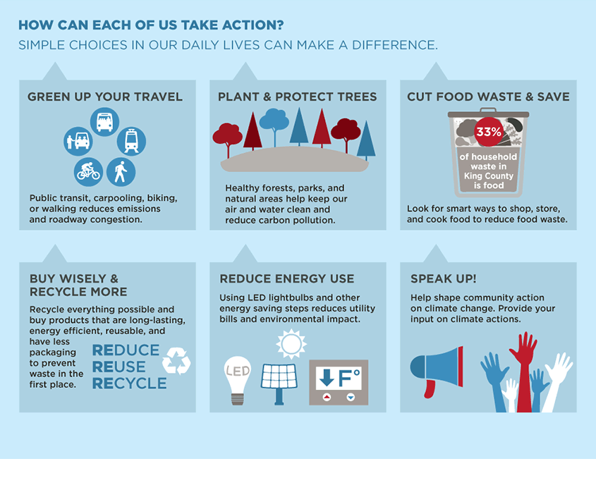

Climate Change
With increasing global surface temperatures and climate change, increased incidence and intensity of drought conditions is likely occur. Droughts lead to dry, hot conditions which increase wildfire risk.
Do your part to reduce climate change to help prevent future droughts and wildfires!
Infographic from King County. WA

